Slide 1
Docker

Slide 2
Docker
Introduction.
Issues Before Containerization.
What is a Container?
Container vs VM.
Why do we need containers?
What is Docker and why docker?
Docker Architecture.
Docker Installation and Setup.
Docker Environment.
Docker Images.
Docker Registry and How To Use DockerHub.
Docker Objects.
Docker File.
Docker Compose.
Docker Swarm.

Slide 3
Docker
17. Docker Best practices
19. Docker Instruction Best Practices
20. Implementing Docker File Best Practices
21. Docker Storage
22. Docker Networks
25. AWS ECR
26. AWS ECS
27. Monitoring in Docker

Slide 4
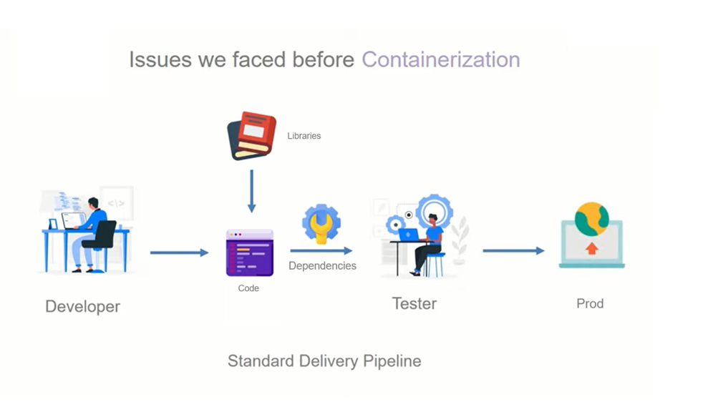
Introduction of Docker

Slide 5
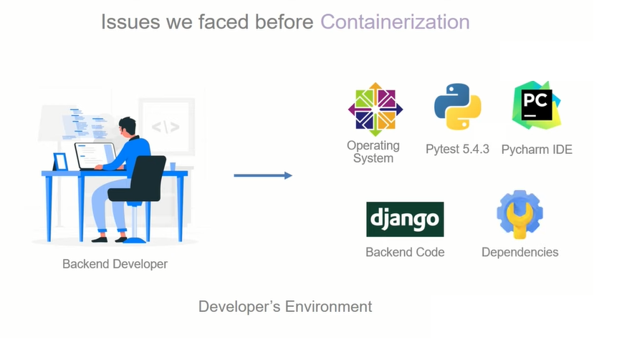
Introduction of Docker

Slide 6
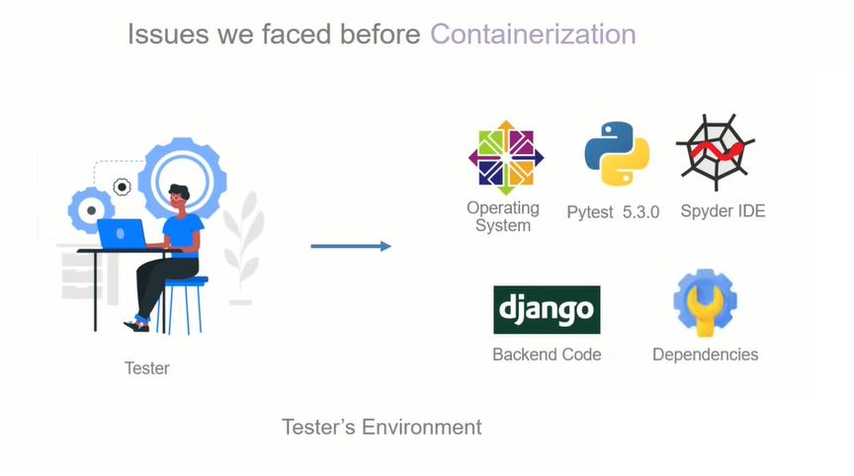
Introduction of Docker

Slide 7
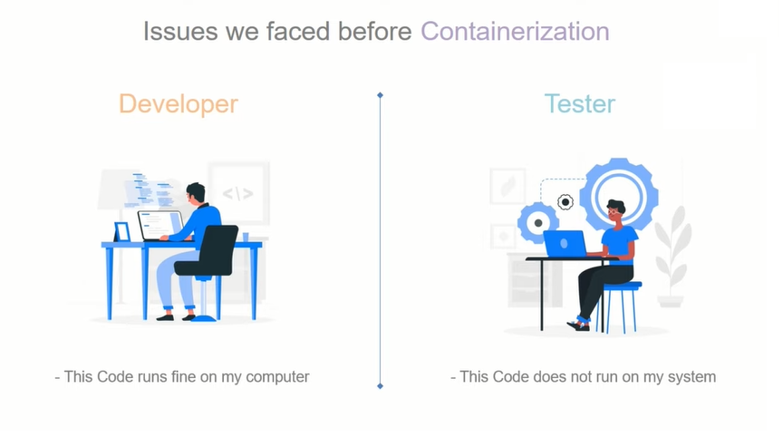
Introduction of Docker

Slide 8
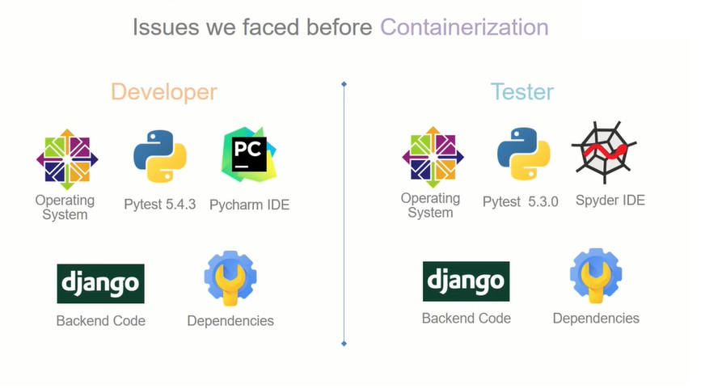
Introduction of Docker

Slide 9
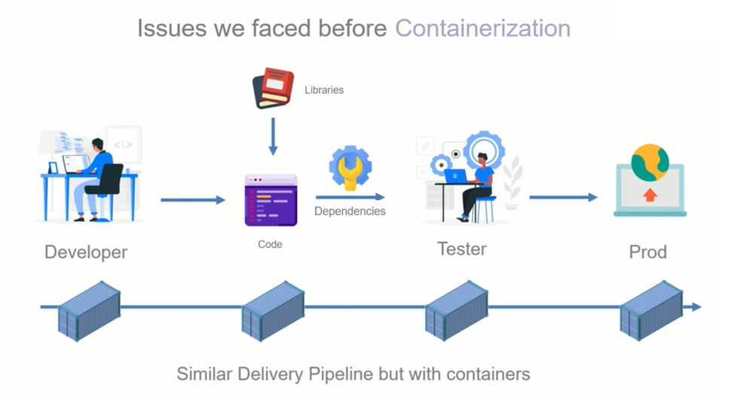
Introduction of Docker

Slide 10
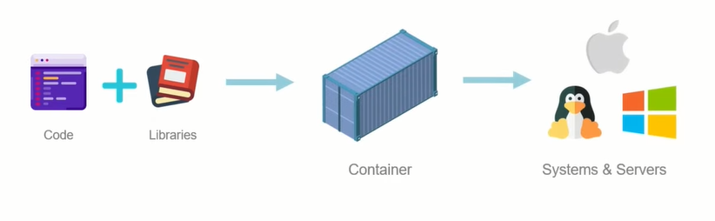
What is Container ?
Containers are software that wrap up all the parts of a code and all its dependencies into a single deployable unit that can be used on different systems and servers.

Slide 11
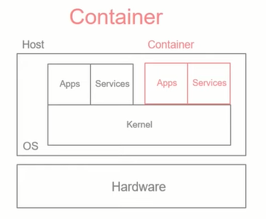
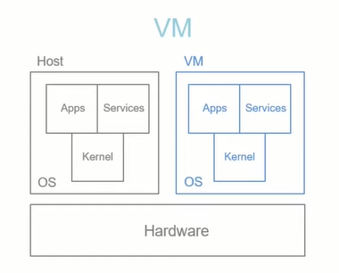
Containers vs VM
Criteria | Containers | Virtual Machines
Operating System | Contains only bear minimum parts of OS required to run software. Updates are easy and simple to do. | Contains the complete OS that is normally used on systems for general purpose. Updates are time consuming.
Architecture
Isolation | Containers shares host OS and kernel. Containers act like software in host env. | VM having its own OS and kernel. Isolated from host.

Slide 12
Containers vs VM
Criteria | Containers | Virtual Machines
Efficiency | Containers are most efficient than VM because its uses only bear minimum parts of operating system. | VM’s are less efficient than containers because they have to manage full blown guest operating system.
Portability | Containers are self contained environments that can be used on different operating systems. | VM’s aren’t that easily ported with the same settings from one operating system to another.
Scalability | Containers are light weight so they can easily scale and can be added and removed based on requirements. | VM’s are heavy weight so aren't very easily scalable.
Deployment | Containers can be deployed easily using the Docker CLI or making use of Cloud services provided by AWS or Azure. | VM’s can be deployed using the powershellor by using the VMM or using cloud services such as AWS or Azure.

Slide 13
Why do we need Container ?
To maintain Consistent development environments.
To implement micro service-based application.
Microservices- Is an architectural style that structures an application as a collection of services that are loosely coupled, Independently deployable, owned by a small team etc.
Example. Food delivery app having different modules like Paymate, Tracking order, SMS, Searching food so these are the different modules which we can developed independently as micro service.
Containerization: Containerization is a form of virtualization where applications run in isolated user
spaces, called containers, while using the same shared operating system (OS). One of the benefits
of containerization is that a container is essentially a fully packaged and portable computing
environment.

Slide 14
What is Docker and Why Docker?
Docker is tool or an open platform for developing, shipping and running applications in isolation. It does so by creating containers that completely wrap a software.
Docker is not the only container tool. There are many container tools available like rkt, Podman, LXC, Hyper-V and Windows Containers etc.
Why Docker?
Simple.
Fast.
Easy Collaboration.
Built for Developers by Developers.
Big Docker community contributing many new things, images.

Slide 15
Docker installation & Setup
We can install docker on Linux, Mac or Windows operating systems. We can also install docker desktop version on your personal computer.
Installation methods on Ubuntu Operating System
Method 1: Directly using ubuntu package manager
~ sudo apt update –y
~ sudo apt install docker.io -y
~ docker –version
~ sudo apt remove docker.io –y
Disadvantages of method 1 is that sometime in ubuntu, packages are not updated so will not get updated Docker version installed.

Slide 16
Docker installation & Setup
Method 2: Using Docker repository.
# Add Docker's official GPG key:
~ sudo apt-get update
~ sudo apt-get install ca-certificates curl
~ sudo install -m 0755 -d /etc/apt/keyrings
~ sudo curl -fsSL https://download.docker.com/linux/ubuntu/gpg -o /etc/apt/keyrings/docker.asc
~ sudo chmod a+r /etc/apt/keyrings/docker.asc
# Add the repository to Apt sources:
~ echo \
"deb [arch=$(dpkg --print-architecture) signed-by=/etc/apt/keyrings/docker.asc] https://download.docker.com/linux/ubuntu \
$(. /etc/os-release && echo "${UBUNTU_CODENAME:-$VERSION_CODENAME}") stable" | \
sudo tee /etc/apt/sources.list.d/docker.list > /dev/null
~ sudo apt-get update
~ sudo apt-get install docker-ce docker-ce-cli containerd.io docker-buildx-plugin docker-compose-plugin
~ sudo systemctl start docker
~ sudo systemctl status docker

Slide 17
Docker Environment
Docker Engine
Docker Objects
Docker Registry
Docker Compose.
Docker Swarm.

Slide 18
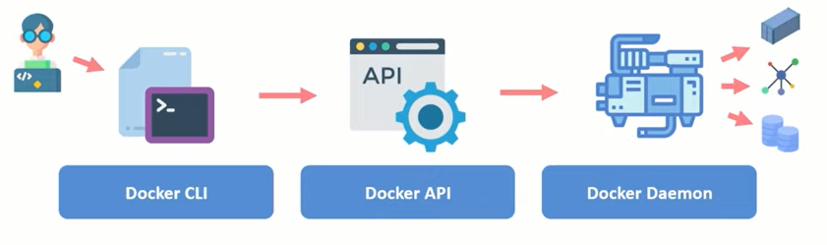
1. Docker Engine.
Docker Engine is as the name suggests, its technology that allows for the creation and management of all the Docker Processes. It has three major parts to it.
Docker CLI.
Docker API.
Docker Daemon.

Slide 19
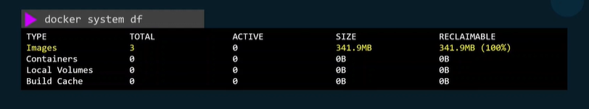
2. Docker Objects.
Docker Images.
Docker Containers.
Docker Volumes.
Docker Networks.
Docker Swarm Nodes.
Docker Swarm Services.
Docker Swarm Stack.

Slide 20
A. Docker Objects - Images.
Docker images are sets of instructions that are used to create containers and execute code inside it.
Common Commands:
Pull docker image.
~ sudo docker pull <image_name>
List docker pulled images.
~ sudo docker images
Push docker image.
~ sudo docker tag old_image_name new_image_name (repo_name/image_name)
~ docker login
~ docker push image_name
Remove docker image.
~ docker rmi image_name
Remove docker all images.
~ docker rmi -f $(docker images -a -q)

Slide 21
B. Docker Objects - Container.
Docker Container are software that wrap up all the parts of a code and all its dependencies into a single deployable unit that can be used on different systems and servers.
Common Commands:
Create container from image.
~ sudo docker run –it –d <image_name>
-it = interactive mode
-d = detached mode (run in background)
To see created containers.
~ sudo docker ps
~ sudo docker ps -a
Create container from image with name and expose on port.
~ sudo docker run –it –d –-name mycontainer <image_name>
~ sudo docker run –it –d –-name mycontainer –p 80:8080 <image_name>
80 host port
8080 container port

Slide 22
B. Docker Objects - Container.
Enter inside container.
~ sudo docker exec –it <container_name or container_id> bash
Stop, start or restart container.
~ sudo docker stop <container_name or container_id>
~ sudo docker start <container_name or container_id>
~ sudo docker restart <container_name or container_id>
See stopped or exited container.
~ sudo docker ps -a
Kill container.
~ sudo docker kill <container_name or container_id>
Difference between docker stop and docker kill
Docker stop always wait for running process to get stop before stopping container but docker kill is more
aggressive it will forcefully stop container it will not wait for running processes to get stopped.

Slide 23
B. Docker Objects - Container.
Remove docker container.
~ sudo docker rm <container_name or container_id>
~ sudo docker rm –f <container_name or container_id>
-f = forcefully remove container without stopping it.
~ sudo docker rm $(docker ps –aq)
~ sudo docker rm $(docker ps –-filter status=exited -q)
Save container which you created and worked as image.
~ sudo docker commit <container_name or container_id> <custom-image-name>
Rename existing Docker container.
~ sudo docker rename <existing_container_name> <container_new_name>

Slide 24
C. Docker Objects - Volumes.
Containers are designed to be ephemeral. When a container is stopped, removed, or recreated, any data stored within its writable layer is lost.
Docker Volumes are basically persistent storage locations for the containers. They can be easily & safely attached and removed from different container. And they are also portable from system to another.
Data Persistence, Data Sharing, Improved Performance, Simplified Data Management, Portability and Flexibility
Volumes drivers allows you to perform unique abilities such as creating persistent storage on other hosts, cloud, encrypt volumes. They basically enhance the abilities of a Volume.

Slide 25
D. Docker Objects - Network.
Docker Networks is basically a connection between one or more containers running on same host or on different hosts. One of the more powerful thing about the docker container is that you can connect them together or connect them to non-docker workloads.
Docker Network Drivers:
Bridge
Host
Overlay
Ipvlan
Macvlan
None
Network plugins

Slide 26
3. Docker Registry.
Docker Registry you can think of registries as storage locations for Docker Images. These images can be versioned in the registry as well.
You can pull images from docker registry or push your images into registry. There are many container registries available like Docker Hub, AWS Elastic Container Registry, Azure Container Registry or you can deploy your own private registry on your servers also.
Pull docker image.
~ sudo docker pull <registry_name>/<image_name>:<image_tag>
Push docker image.
~ sudo docker tag old_image_name new_image_name
~ docker login
~ docker push image_name

Slide 27
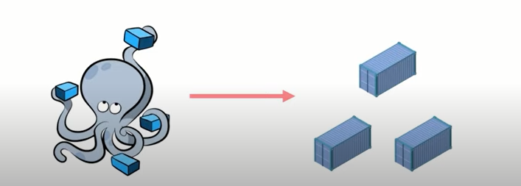
4. Docker Compose.
For now, let’s just understand that Docker Compose is just a service withing Docker that let’s us launch multiple containers at the same time.

Slide 28
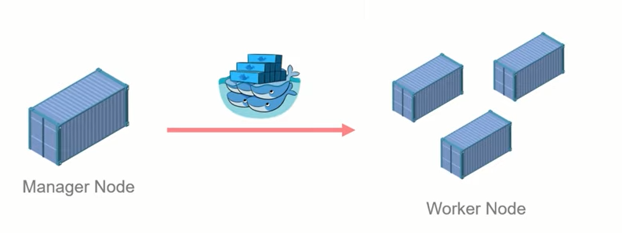
5. Docker Swarm.
For now, just understand that Docker Swarm is a service withing Docker that allows us to manage multiple containers. It is Docker Orchestration tool.

Slide 29


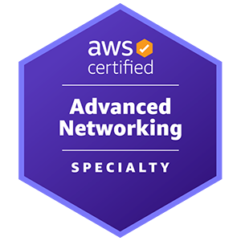

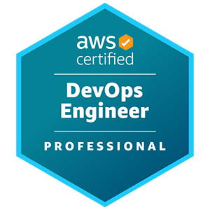
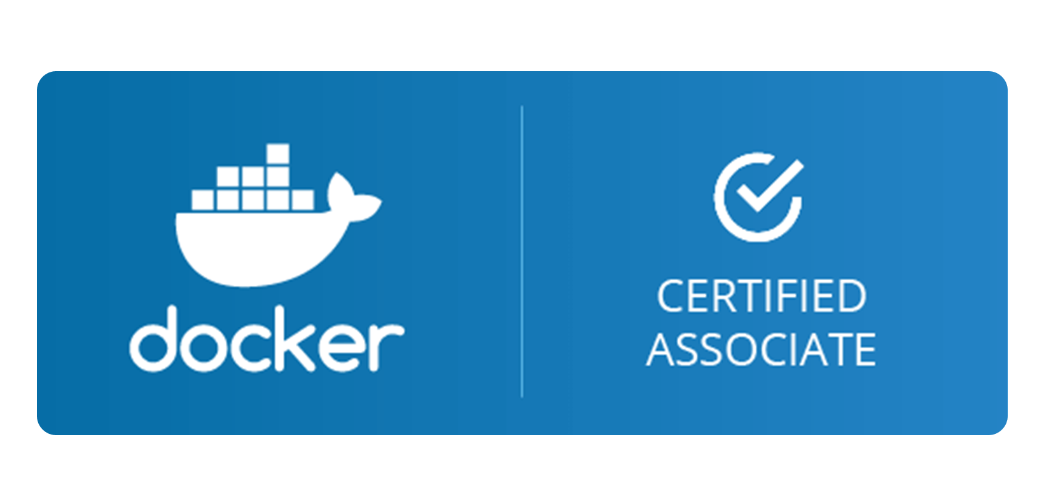
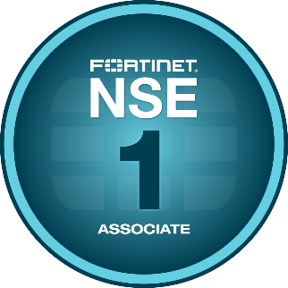

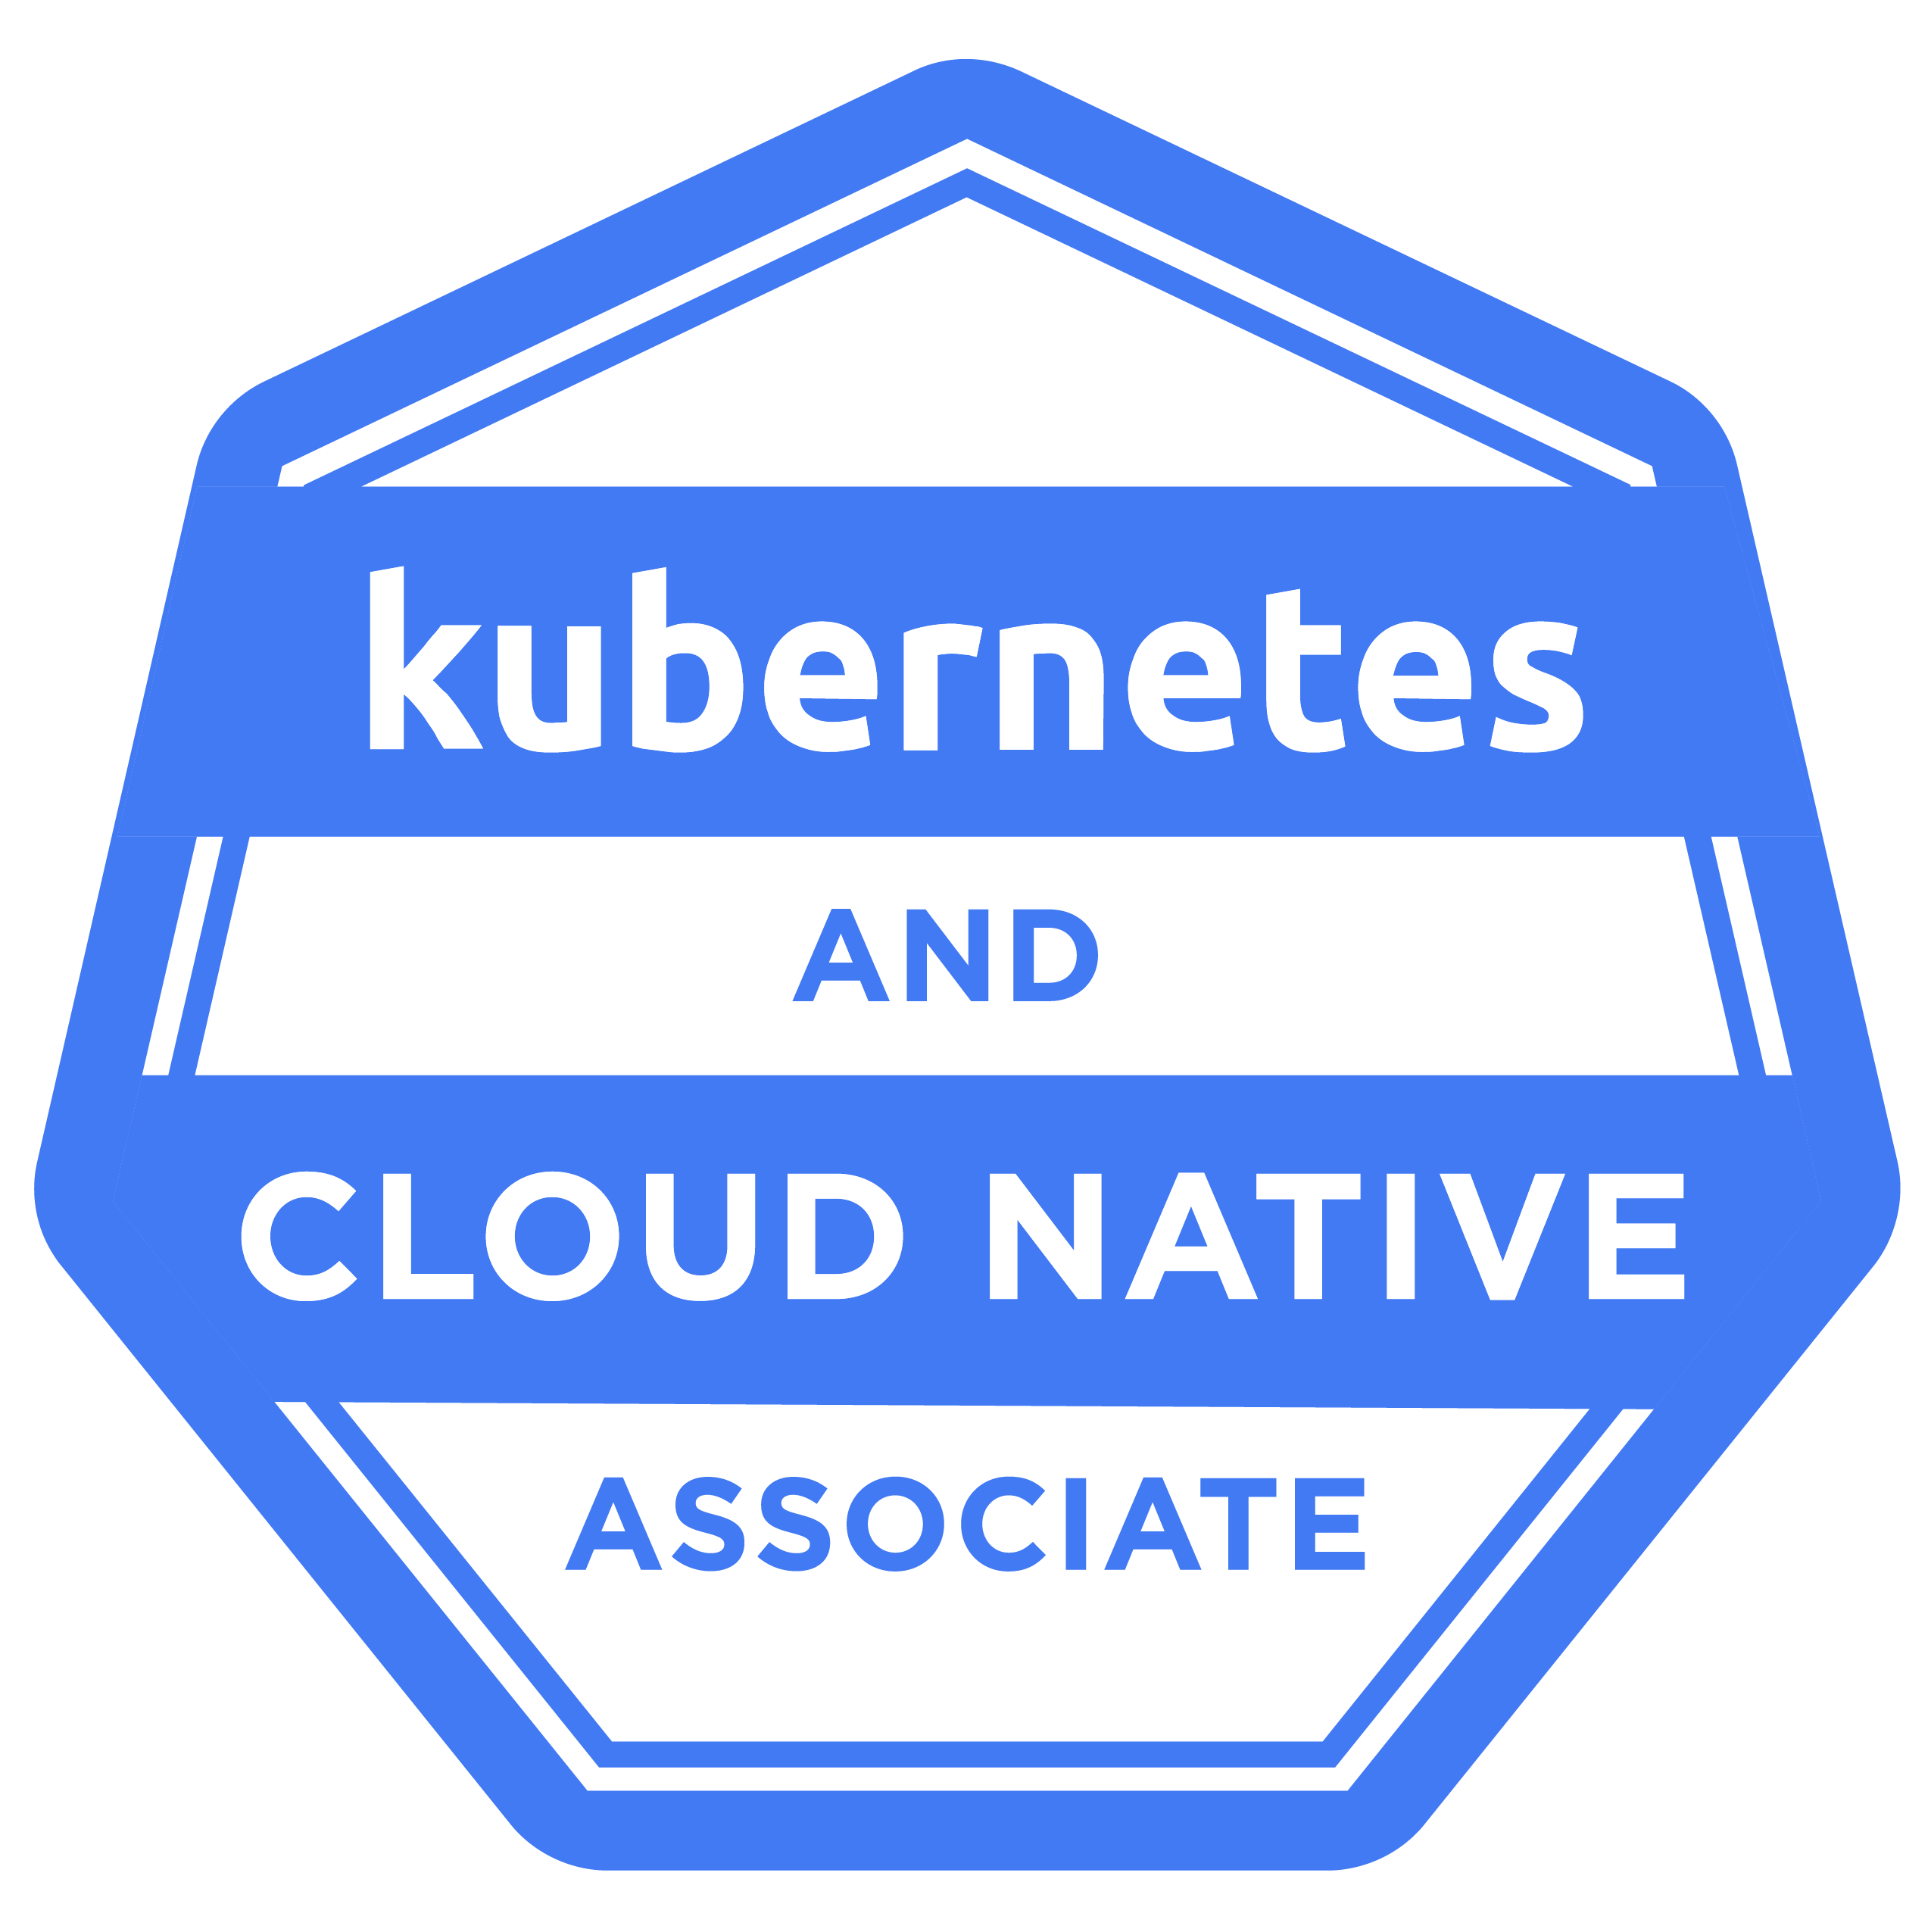
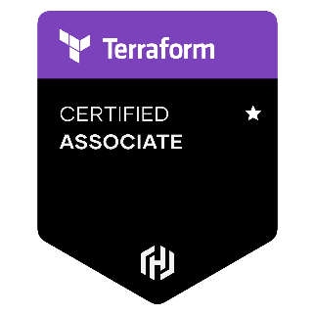
Why should I learn from you.
Sr. AWS DevOps Architect with extensive experience in cloud infrastructure, automation, and DevOps practices. Has successfully led multiple high-profile projects involving cloud migrations, EKS setups, and automation using tools like Terraform, GitHub Actions, GitLab, ArgoCD, Docker and Kubernetes.

Slide 30
Thank You !
Cloudwaale
https://www.cloudwaale.com/
+91 9167093936

